Slide 1
Lab 1 Final
3.5.2021
Kylie Outlaw & Maria Abbasi

Slide 2
Loop Timing
Task #4 Implementation
TIM2 on PA0
Count-up timer
Period of 7,000,000 (1 second)
Pre-scalar of 12
Every clock tick is 1/7 microsecond
Struct objects used to keep track of different loops’ timing
Total elapsed time stored using a uint32_t
Number of loops tracked using a uint16_t counter
Averages based on 65,535 consecutive loop timings for inner/outer loops
Averages based on 30 consecutive loop timings for the blink loop

Slide 3
Loop Timing
Task #4 Implementation
New “Loop_timer.h” and “Loop_timer.c” files
Holds data and functions for the “loop_timer” struct
Init, begin, stop, reset, print functions
Start tick
End tick
Total time
Number of loops completed
Each loop is measured using a uint16_t counter
Averages based on 65,535 consecutive loop timings
Blink loop uses HAL_tick timing, all others use TIM2 ticks

Slide 4
Interrupt Implementation

Slide 5
Interrupts Used
ADC
UART Tx
GPIO
TIM2

Slide 6
Before Interrupt Implementation

Slide 7
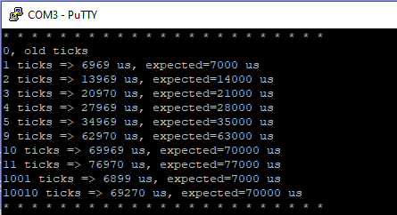
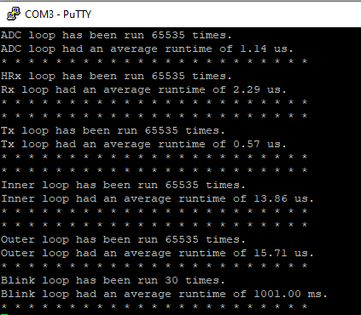
Loop Timing – Before
- Adjusted the main.c calibration to test TIM2 ticks.
- Looking at the output, 7000 clock ticks match 1 HAL tick
- With best case scenario:
- ADC: 1.14 us
- Rx: 2.29 us
- Tx: 0.56 us
- Inner loop (all 3 tasks): 13.86 us
- Outer loop (sch_loop): 15.72 us
- Blink loop: 1001 ms
Com 3 Output – Timing Calibration
Com 3 Output – Best Case Timing

Slide 8

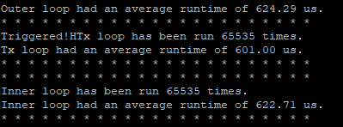

Loop Timing - Before
- Worst case scenario was made by holding T on the keyboard (engaged Rx & ADC tasks) and the button (engaged Tx task).
- These were held until timings were output
- With best case scenario:
- ADC: 9.57 us
- Rx: 2.43 us
- Tx: 601.00 us
- Inner loop (all 3 tasks): 622.71 us
- Outer loop (sch_loop): 624.29 us
- Blink loop: 1001 ms
- Every single task timing increased
Image: COM3 output – worst case

Slide 9
After Interrupt Implementation

Slide 10
Current Schedule Priority
Sch_basic.c - sch_loop()
Polled tasks – checks tasks in loop for hardware conditions
First scheduled, first checked, first executed
ADC ➡ UART Rx ➡UART Tx

Slide 11
Current Schedule Priority
Tasks_lab_1.c - sch_create_timeout()
Based on tick timeout
Higher priority than polling loop
Every ~1s LED toggles

Slide 12
Scheduling Approach
Asynchronous events handled by hardware interrupts
HAL_GPIO_EXTI_Callback();
Break tasks into priority groups
HAL_NVIC_SetPriority() : 0 to 15
If multiple asynchronous interrupts occur at same time, highest priority gets completed first

Slide 13
Scheduling Approach
Synchronous events / periodic tasks handled by timer interrupts
Set up timer with interrupt at each period time
Set HAL_TIM_Period_ElapsedCallback() to process
Will need the period of all synchronous / periodic tasks

Slide 14
Scheduling Approach
Application – data processor and transmitter
Frequent UART Tx calls with many bytes of data in main()
In general, favoring interrupts over polling…
Allows code to prioritize interrupt events & react quicker to user input
Offloads to hardware to reduce load on software for situations with a ‘busy’ main()
Reduces cycle time
Utilizes more components of the MCU

Slide 15
Questions?

